Slide 1
Rockbuster Online Video Movie Rental Recommendation
January 18, 2021

Slide 2
Background
Understanding that the competitive landscape is ever-changing and evolving, Rockbuster would like to use their existing movie licenses to launch an online video movie rental service to become and remain competitive with other online services like Apple TV, Hulu, Netflix, and Amazon.
To better understand how to market and where to launch this new service, we looked at the following:
The average rate of rental
The average rental duration
Top 10 counties
Top 10 cities
Top spending customers

Slide 3
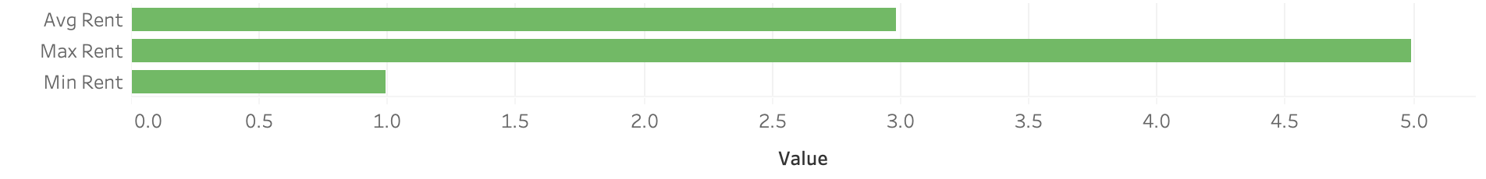
Average rental Rate
The average duration for a rental is 5 days, and least is 3 days and the most is 7 days.

Slide 4
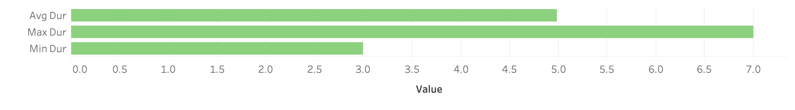
Average Rental Duration
The rental rate average is $2.98 and the highest is $4.99 and the lowest is $0.99.

Slide 5
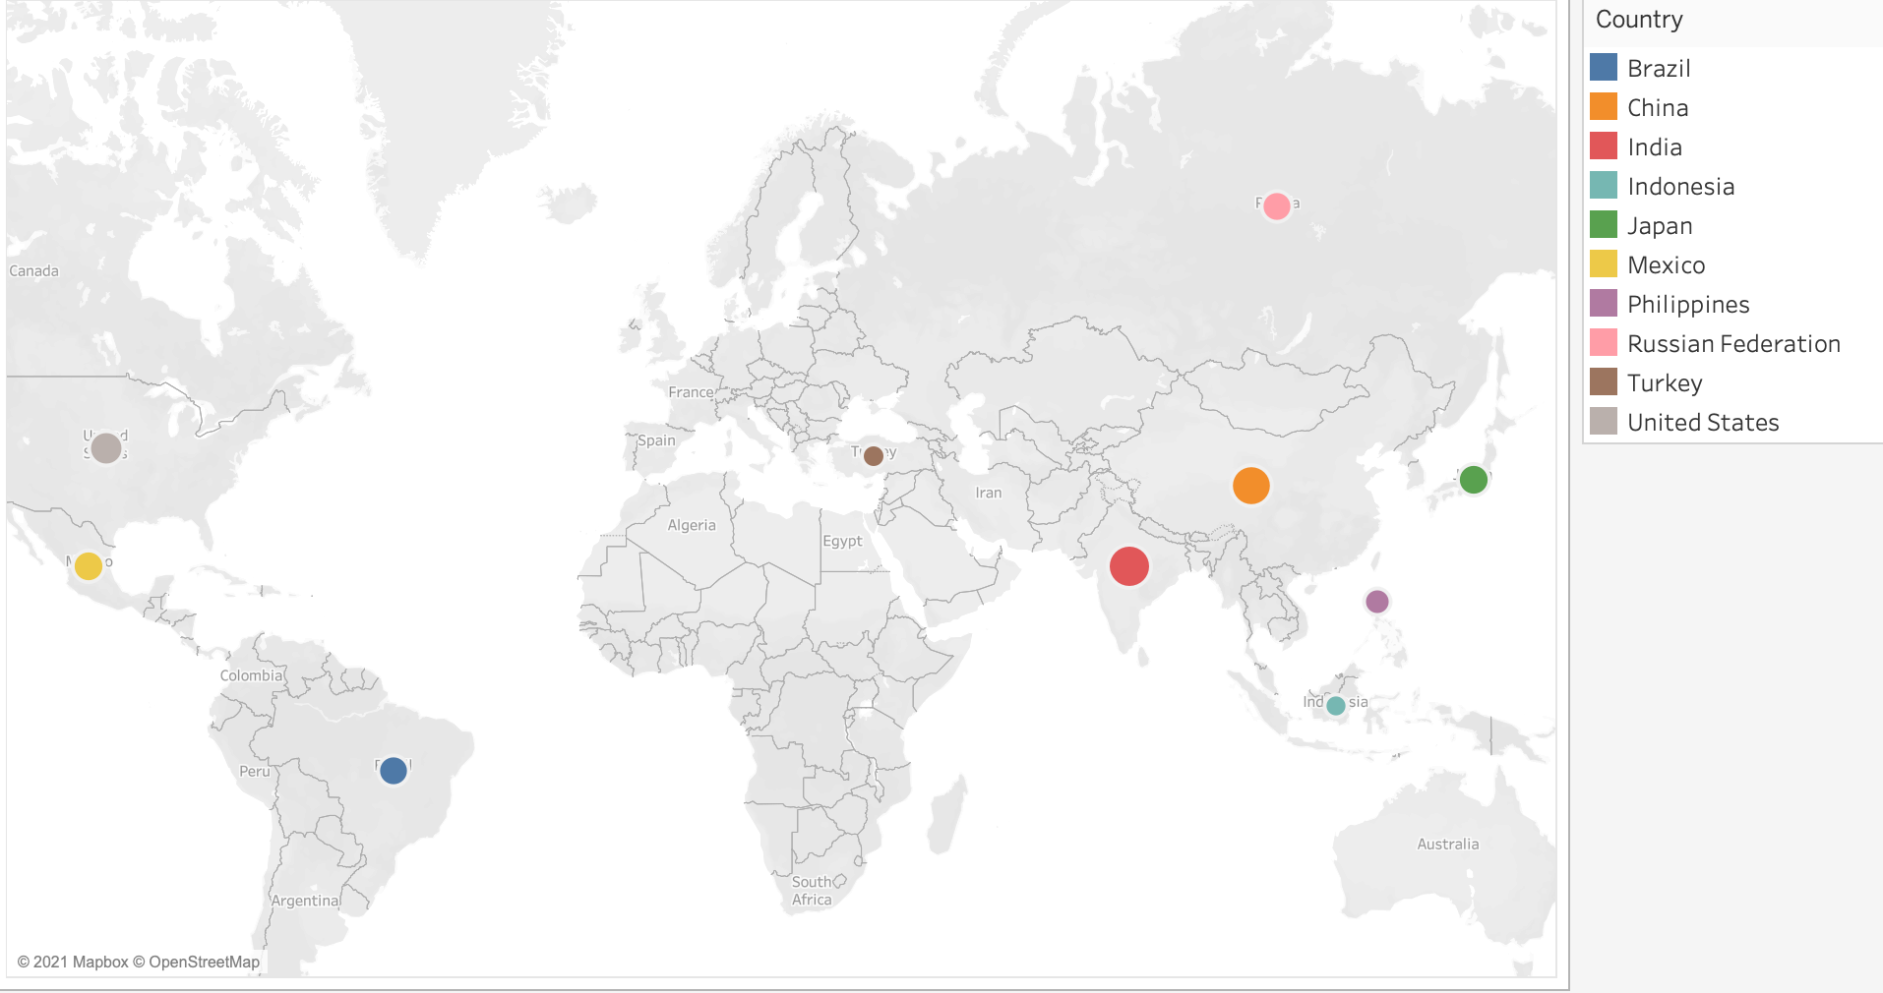
Top 10 countries
Majority of the countries are in Asia, of which two-span over Asia and Europe, followed by North America. The top 3 countries are India, China, and the United States.

Slide 6
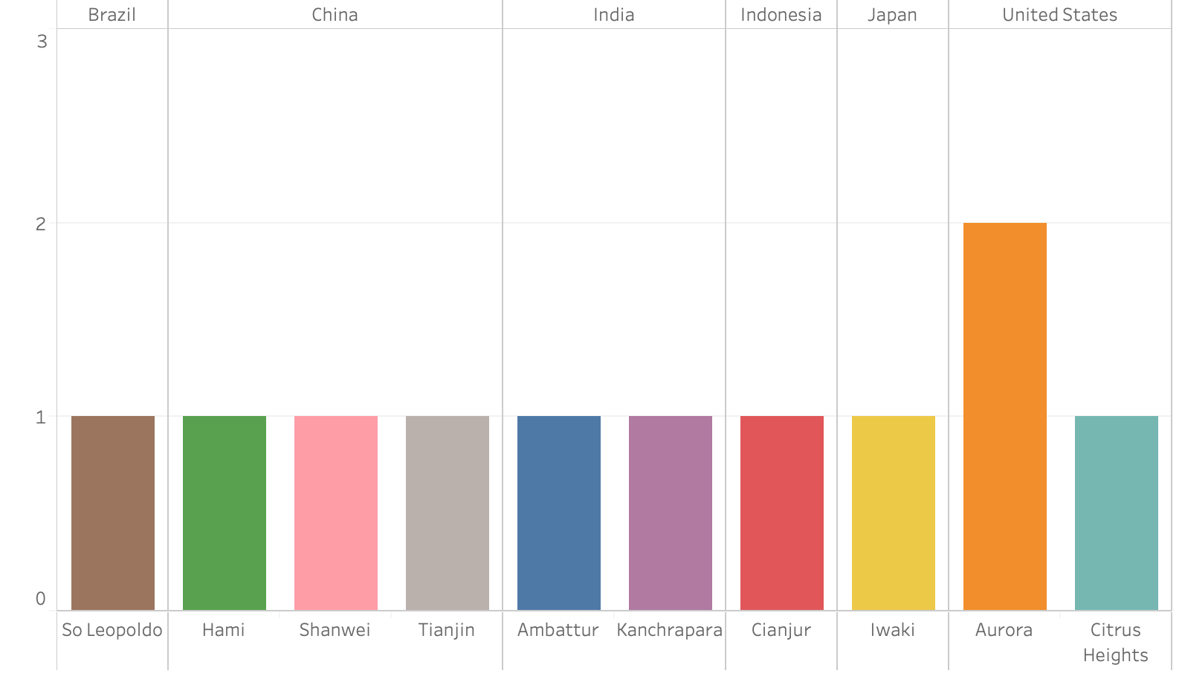
Top 10 cities
China is home to three of the top cities followed by India and the United States

Slide 7
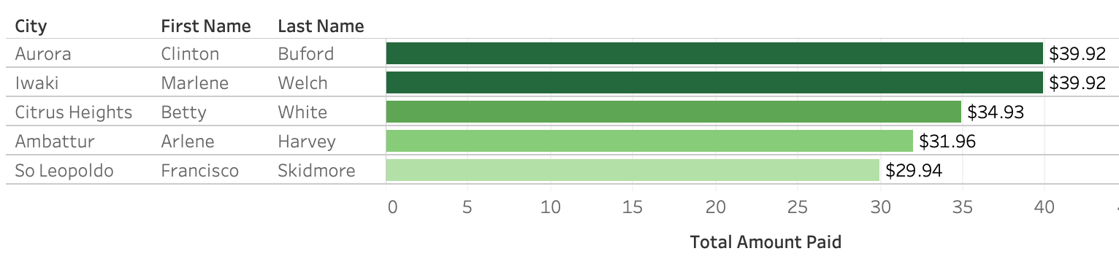
Top 5 Customers
All customers in the top 5 spent over $29.94.

Slide 8
Recommendation
Look at capping length of access, based on the data 5 days seems to be sufficient.
Keep rental rates below $4.99, while the average is $2.98 there is some room to bump up the average.
Focus marketing India, China, and the United States based on data from top 10 countries and top 10 cities.
Focus on increasing sales in U.S. as they have 2 in the top 5 of customer spend and, also, look at China. While China doesn’t have more than one customer in the top 5, they are 2nd in the top 10 countries.

